Slide 1


TechLab Workshop
主讲人：向阳
时间：2021.02.22

Slide 2
OUTLINE
Internal Training
What is Github?
Repositories
Explore
Useful Repo sharing

Slide 3
Part One
What is Github?

Slide 4

What is Github
Internal Training
Github是一个基于Git的代码托管平台，付费用户可以建私人仓库，我们一般的免费用户只能使用公共仓库，也就是代码要公开。(Github简明教程)

Slide 5
Part Two
Repositories

Slide 6
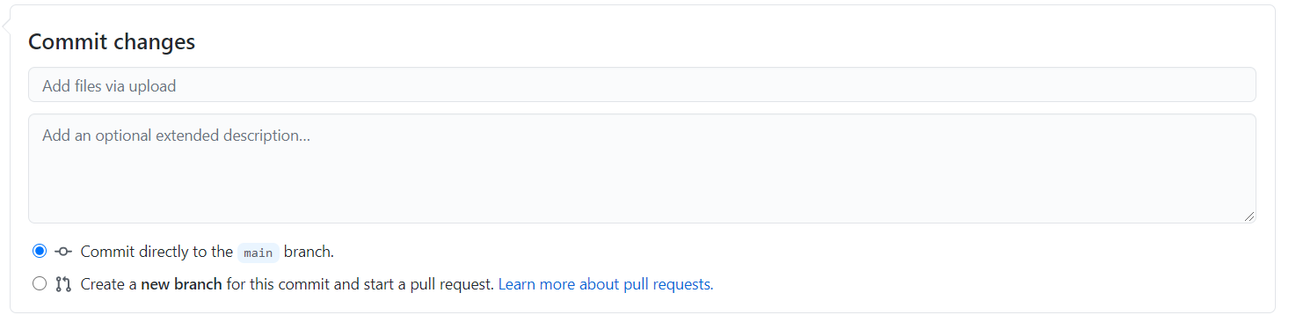
Repositories
Internal Training
Create a new repository
README.md
Upload files
Branch, pull requests, etc.
为什么要维护自己的Github？
Codes/Projects Review
Job Interview

Slide 7
Part Three
Explore

Slide 8
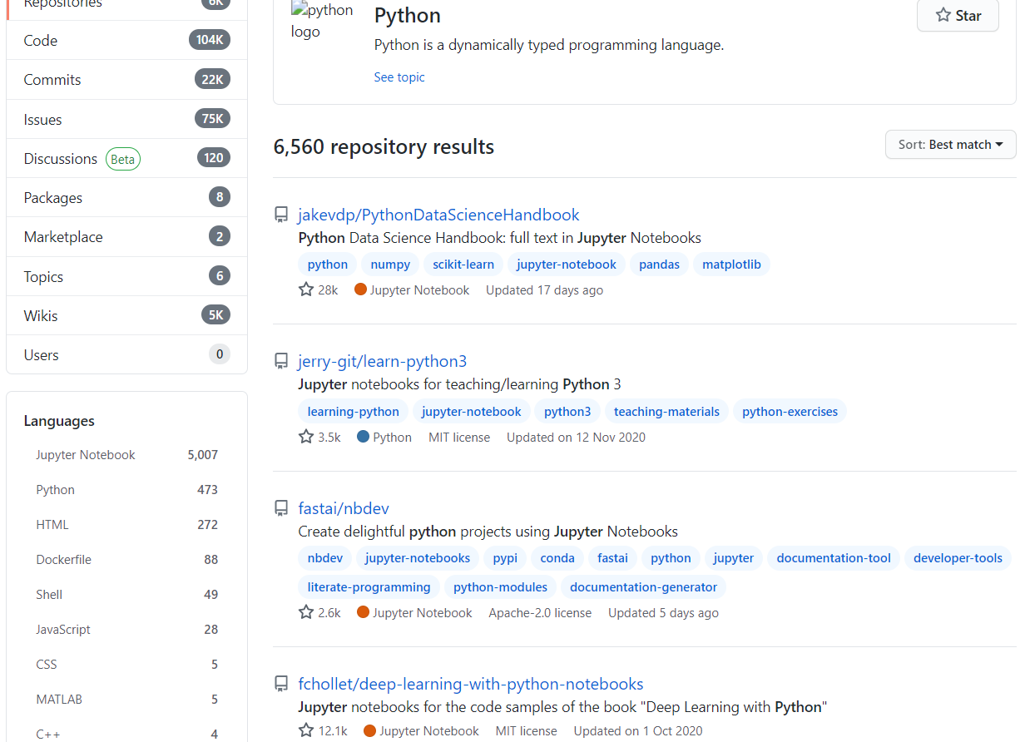
Explore
Internal Training
Search
Numpy stars:>3000
Pandas forks:100..30000
Python&jupyter
Awesome+…
Fork
Star

Slide 9
Part Four
Useful repo sharing

Slide 10

Useful repo sharing
Internal Training
Basics:
Python-100-Days
Free-python-games
Libraries:
100-pandas-puzzles
Numpy-100
Data:
Awesome-spider
Learn_python3_spider

